Slide 1

F.L.O.A.T.
SSE Group 3 Presentation
Notes:
Good afternoon everyone I’m Jonathan Vargas with __ Carter
We’re here to present our approach on a proof of concept to aide in monitoring small body of waters and process data for an easy report out.
Carter and I explored different systems learned from our years here and even learned a little bit from different disciplines to tackle water health.
FLOAT

Slide 2
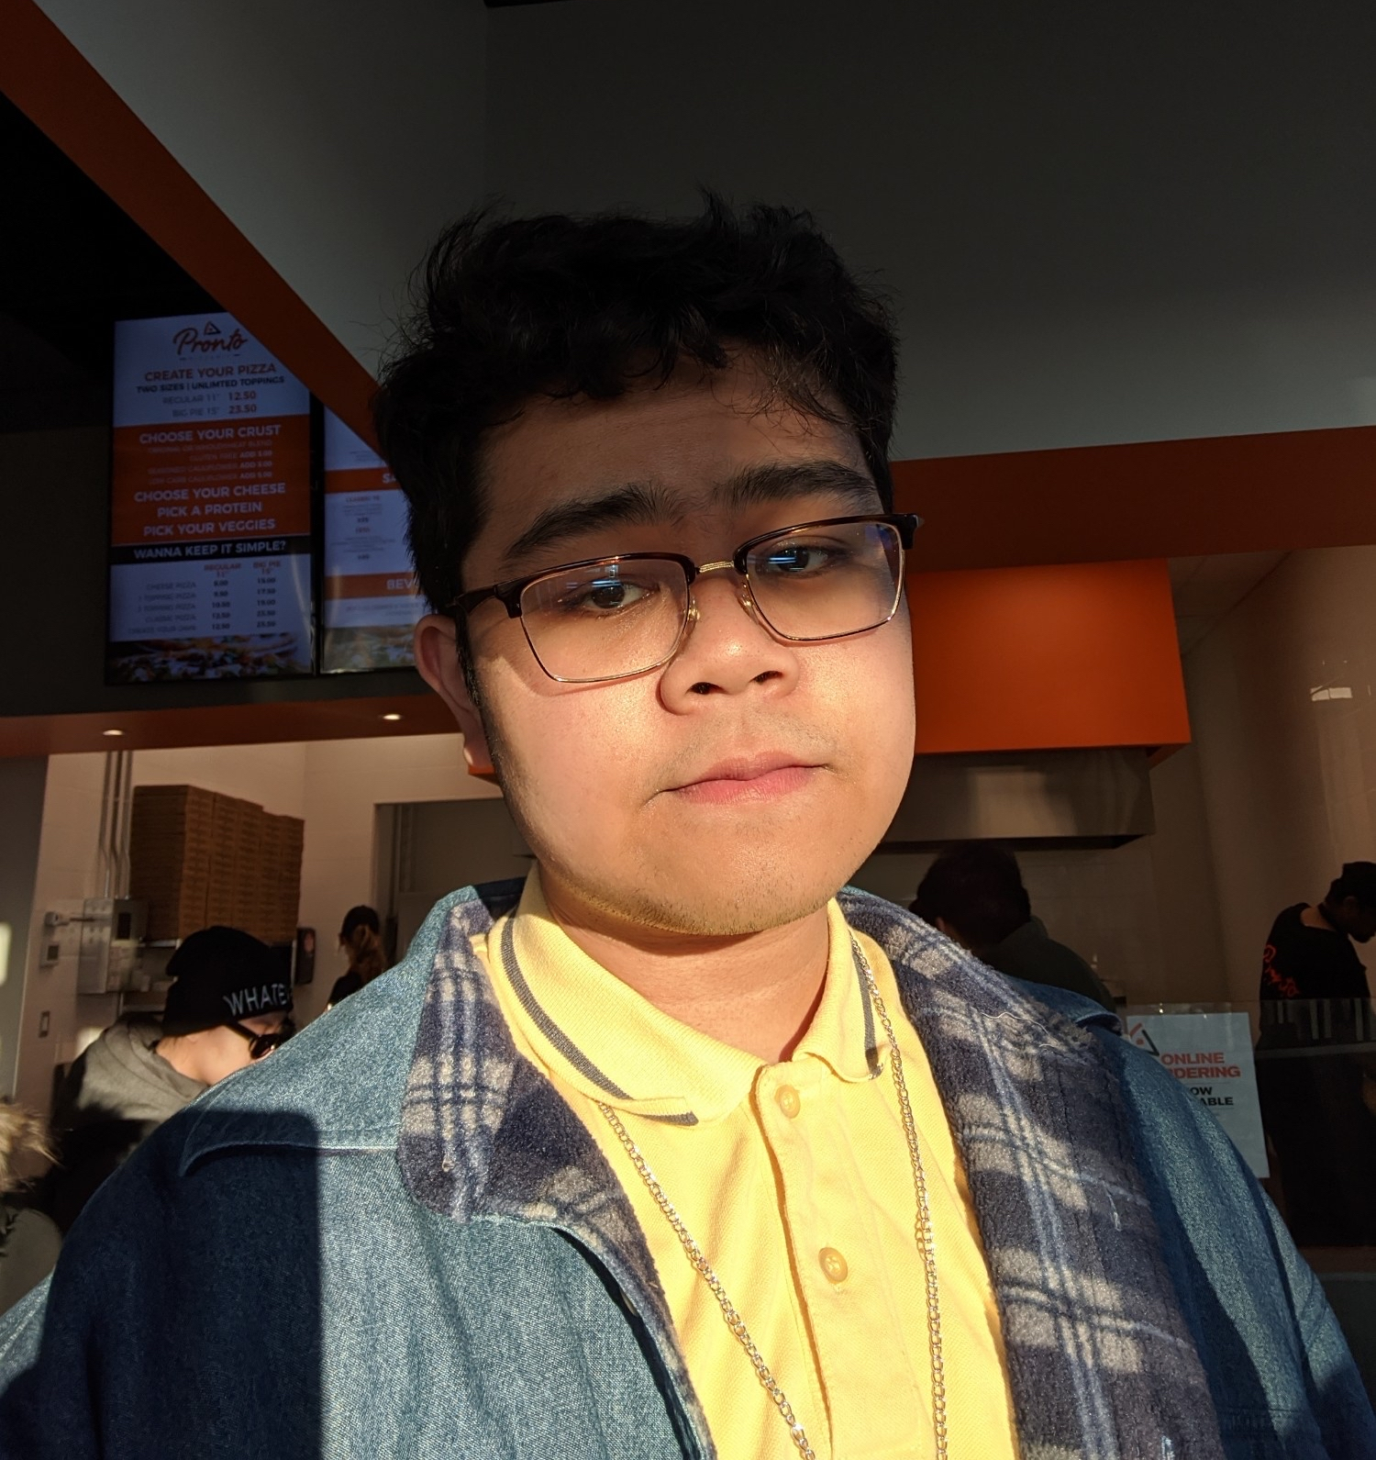
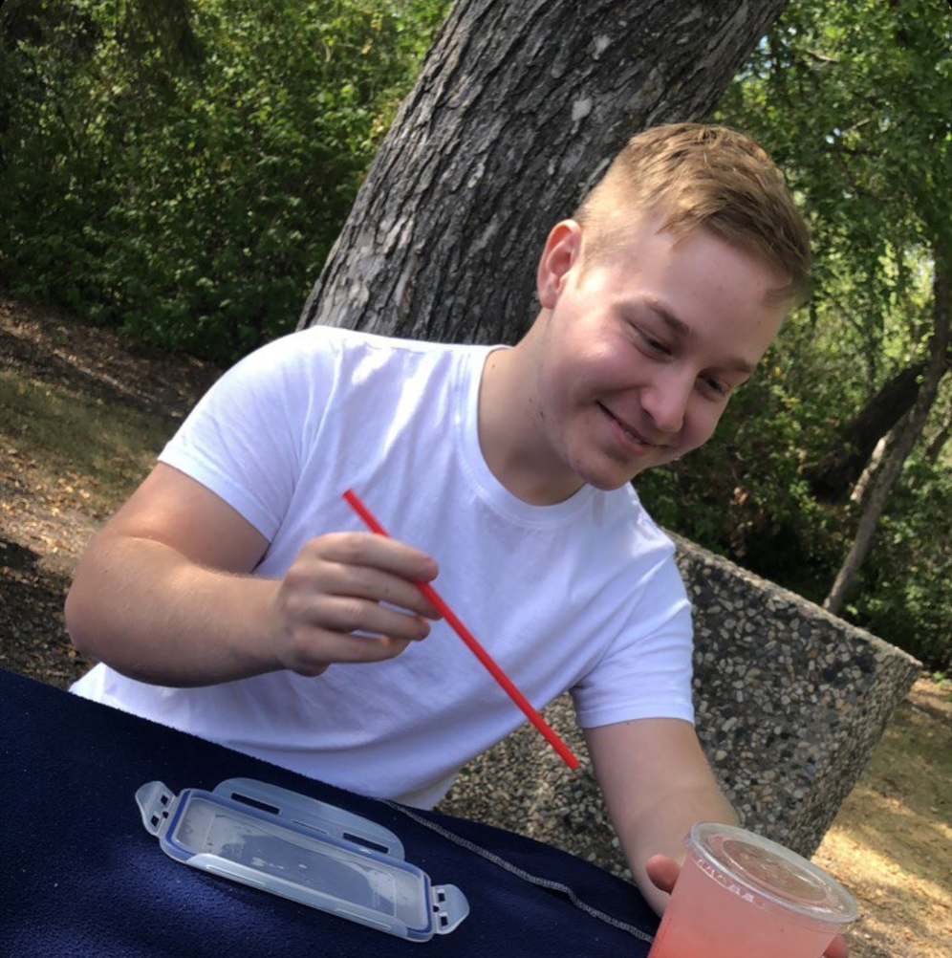
Introductions
Jonathan Vargas
Project Manager
Full Stack Developer
Carter Brezinski
AI Lead
Hardware Lead
Notes:
Lets get know or reintroduce the team that will see this project through.
My name is Jon and I am known as the project manager and full stack developer
C:[carter introduces himself]
A few changes with our roles. with the hardware aspect being more prevalent we decided carter can take that responsibility while I shift into developing our backend and front end services.

Slide 3
Initial Figures
There are 5.25 trillion pieces of plastic debris in the ocean.
-national geographic
218 Tons of Canadian Litter ended up in the ocean in the last 10 years.
-marinelitter.coaps.fsu.edu
Notes:
The topic on water quality came to our attention when campaigns of ocean clean up became more prevalent and shocking figures as you see here was brought to everyone's attention.
A lot of these campaigns we

Slide 4
Our Main Idea
Notes:
The main focus we like to target with FLOAT is to bring these big elusive water quality campaigns to smaller more local

Slide 5
What is F.L.O.A.T?
Facilitating Level Objectives Assessment Technology
Collects data to upkeep waters
Identifies any foreign objects
Creates convenience for sampling
Notes:
3 step process

Slide 6
Why Create F.L.O.A.T?
Litter being found in water isn’t an uncommon occurrence
Collection of water parameters can take time
Provide smaller scale solution
Notes:
So why create a project like float?

Slide 7
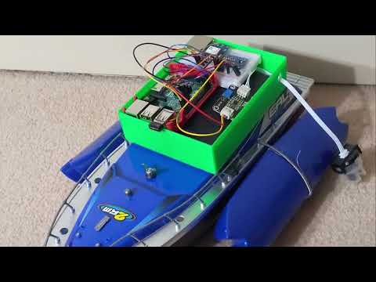
Project commercial
Notes:
To get everyone’s feet wet with our project we’d like show you our product commercial.

Slide 8
Presentation Breakdown
Engineering
Decisions
Technologies, & Strategies
Used
Review, Project Demo & Future Plans
Notes:
Carter:
To give you an idea of what we’ll be talking about in this presentation,
We will outline the engineering decisions made when starting the project
Following this, we’ll describe the architecture, technologies, and strategies used on each part we worked on for this project
Lastly, we’ll give a demo, a review of our time spent on this project, and detail the future plans I have for this project.

Slide 9

Username: floatGuest
Password: floatGuest
Notes:
If anyone wants to ignore us and just mess with our frontend, you can take a look at the url here: A free to use username and password is admin, admin
We know, not very safe.

Slide 10

Engineering Decisions

Slide 11
Planning Out Our Project
Problem Definition
Research
Project
Viability
Brainstorm & Evaluate Solutions
Refactor as
needed
Decide on our design
Notes:
Carter:
In the first month of project I needed to:
Problem definition - we needed to find a problem to solve, in our case, that was litter in Saskatchewan waters
Then we needed to do our research, see if a solution like this is really even viable
Then we need to brainstorm mock solutions, and evaluate how and why they wouldn’t be effective
Once we’ve selected our solution, then we would begin working on initial designs, and refactor as needed

Slide 12
Problem Definition
Capture data
Provide this data on a front-end service
Knowledge base
Start small, with the potential for scalability
Notes:
Carter:
What were the problems that I wanted to solve with this project?
We wanted to:
Capture data on water parameters in Local Saskatchewan Waters
Provide data to parties of interest with an easy to use interface
In addition to this, we wanted to provide a short, but informative knowledge base on this website containing information in regards to what we are currently observing, and what we hope to observe in the future
Lastly, we wanted this project to be built small at first, but be able to scale into a large project later on.

Slide 13
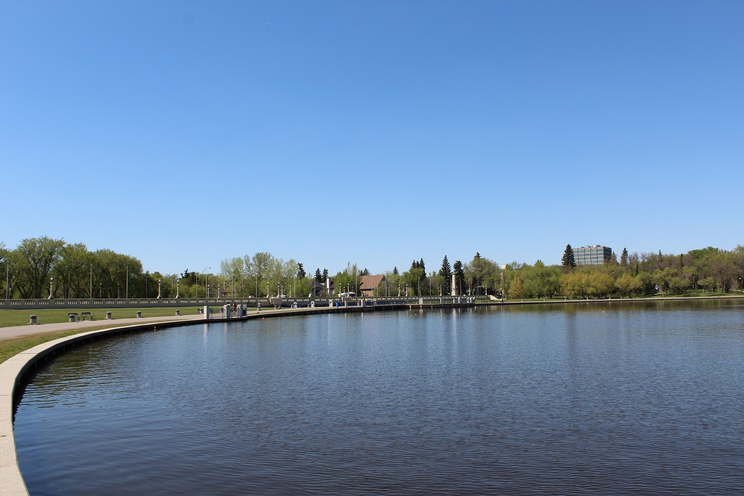
Technologies & Strategies Used
Notes:
Now, lets talk about the architecture, technologies, and strategies used in each portion of our project:

Slide 14
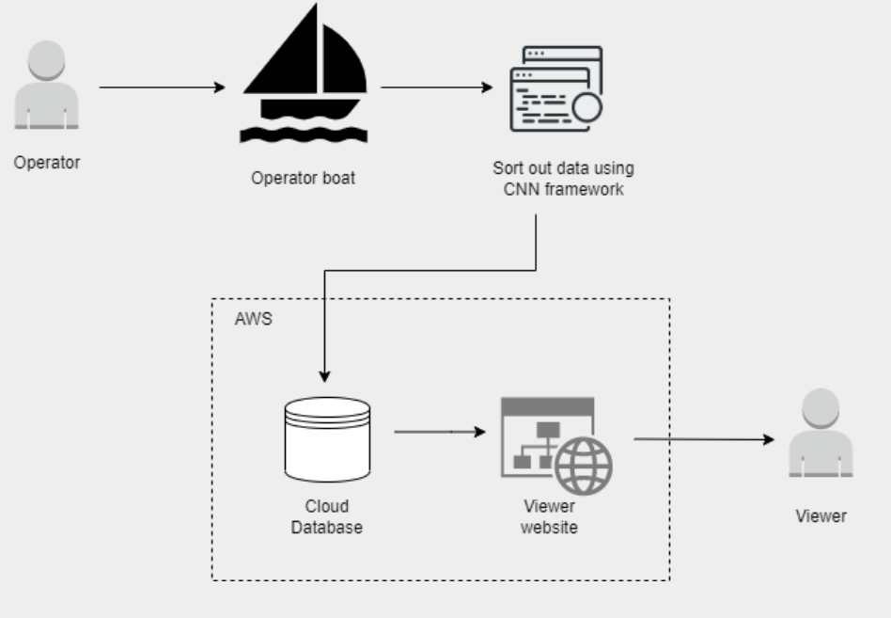
Architecture
Notes:
So our 3 step process can be illustrated here
Collection of data - with the sensors of an operator driven boat
First pass on the data begins with the algorithm to classify the litter.
Second pass happens in a remote server to deem if any water levels are too high or low
Last step is store all of this data in a database where it can be called for viewing.
Now we can get to more specifics in the technologies we used

Slide 15


Architecture
Webpage
PHP, HTML
Database:
mariaDB
Task Queue:
Javascript, CSV
Notes:
TO ENSURE FULL CONTROL OF OUR SYSTEMS WE HAVE OPTED IN BUILDING WITH free open sourced technology.
FOR the webclient I decided to stick well known open source technology.
With php being the main brain of the web client, parsing, and manipulating data. And the main way to call our database.

Slide 16

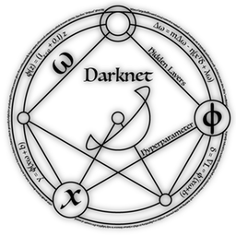
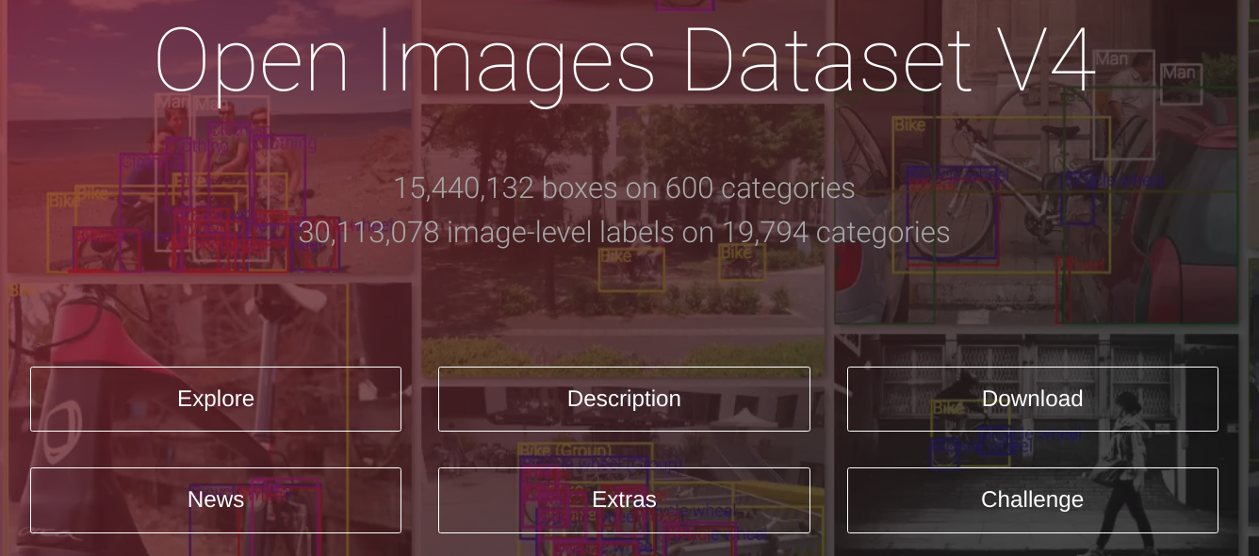
Architecture
Environment
Google Colab
Framework:
Darknet
Dataset:
Google Open Images
Notes:
Carter:

Slide 17
Technologies used:
Machine
Learning
Training & Testing
Training dataset of about 2500 pieces of litter
Testing Dataset of about 600 pieces of litter
Uses:
Convolutional Neural Network
(CNNs)
Trained using 5 objects. With up to 80 future potential additions
Mean Average Precision(mAP): 61.4%
Average Loss: 1.48
Best success took place at around 3300 training batches. When I went past this, over-training began to happen.
Notes:
Carter:
Now, for our technologies used on the Machine Learning portion of our project.
Essentially, it is when you teach an AI system so many times on a particular dataset, that it becomes too finely tuned to the data that it responds poorly to new data. Sometimes fooling itself into making incorrect predictions and spiraling out of control.
This is like teaching a teenager how to drive, but only down one ways, but when you put them on flat ground, they have no idea what they are doing and crash.

Slide 18
How Our Boat Works

Slide 19
Data Parameters
Gathered By Our Boat
Water Turbidity
Geolocation data
Humidity
Temperature
Video data
Notes:
How exactly does our boat work?
Well, as we’ve mentioned several times now, our boat operates by collecting water parameters over the course of time.
These are the following parameters we periodically grab through the use of a python script:
Water turbidity - which is a fancy way of saying water clarity, or the number of particulates in water
Geolocation data - longitude and latitude
Humidity and Temperature of the surrounding environment.
Video data - gathered by a gopro attached to the rig.
This gopro doesn’t directly input data to the boat, but it’s collected data us analyzed after by one of the operators (myself or Jon)
In future iterations of our project, we would be open to expanding the amount of sensors on our boat to include that of pH, and looking for certain types of bacteria

Slide 20
What is machine learning?

Slide 21
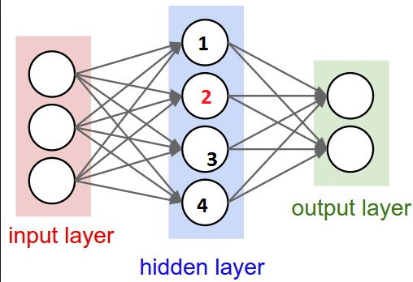
What is machine learning?
Designed to mimic our brain
AI is trained on known labelled images
AI develops an understanding for subtleties
Notes:
In this picture, each one of those blob things is a neuron, when enough electricity is pumped into it from other neurons, it fires electricity down it’s axon into another neuron
The same concept can is seen in the neural network below.
Each one of the circles is a neuron
Each one of the lines coming out of the circles is an axon.
And then some other math magic happens and bam, you’ve got an AI that mimics the human brain in how it learns and how you can teach it

Slide 22
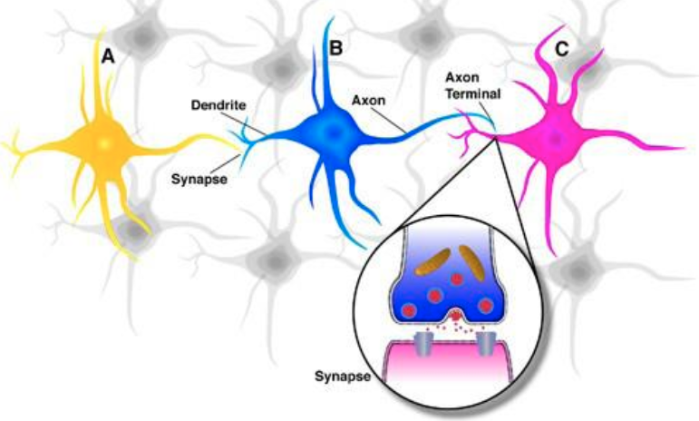
What is machine learning?
Designed to mimic our brain
AI is trained on known labelled images
AI develops an understanding for subtleties
Notes:
In this picture, each one of those blob things is a neuron, when enough electricity is pumped into it from other neurons, it fires electricity down it’s axon into another neuron
The same concept can is seen in the neural network below.
Each one of the circles is a neuron
Each one of the lines coming out of the circles is an axon.
And then some other math magic happens and bam, you’ve got an AI that mimics the human brain in how it learns and how you can teach it

Slide 23

Review, Demos, and Future Plans

Slide 24
Boat Demo
Notes:
So, now I will speak to you all about our most recent boat demo
We took our boat on its longest ride yet, and collected our largest data parameters document as of yet.

Slide 25
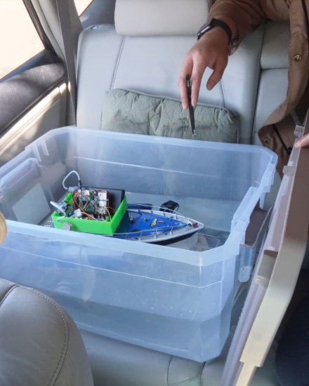
April 6th Test Ride
Notes:
Boat Demo:
As is displayed in the image here, we have our boat, gathering each data previously specified
We transported it in this large tupperware container, so that we could easily keep an eye on all the electronics and make sure no serious water damage took place.

Slide 26
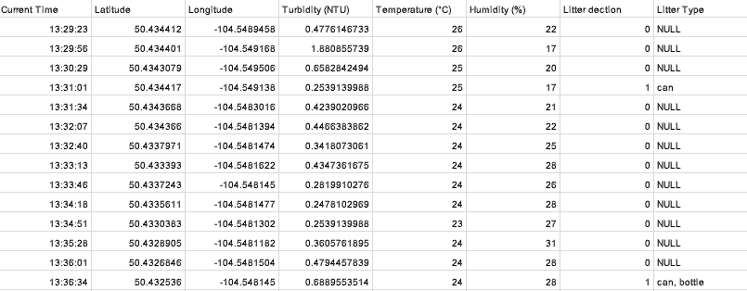
Notes:
Boat Demo:
Over the course of the ride, the boat would gather data, and incrementally add it to this list of parameters.
Once the ride was completed, this csv file, along with the gopro footage, would be extracted by jon and myself for further development

Slide 27
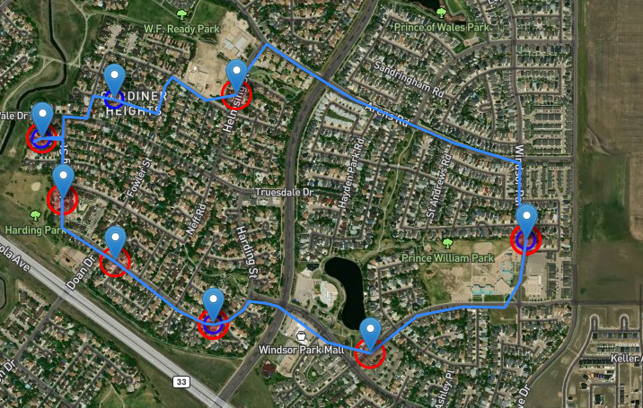
Boat Demo
Notes:
This data was then compiled after runtime into a csv file, which we can then easily implement on Jon’s website, but I will let him explain that in more detail.

Slide 28
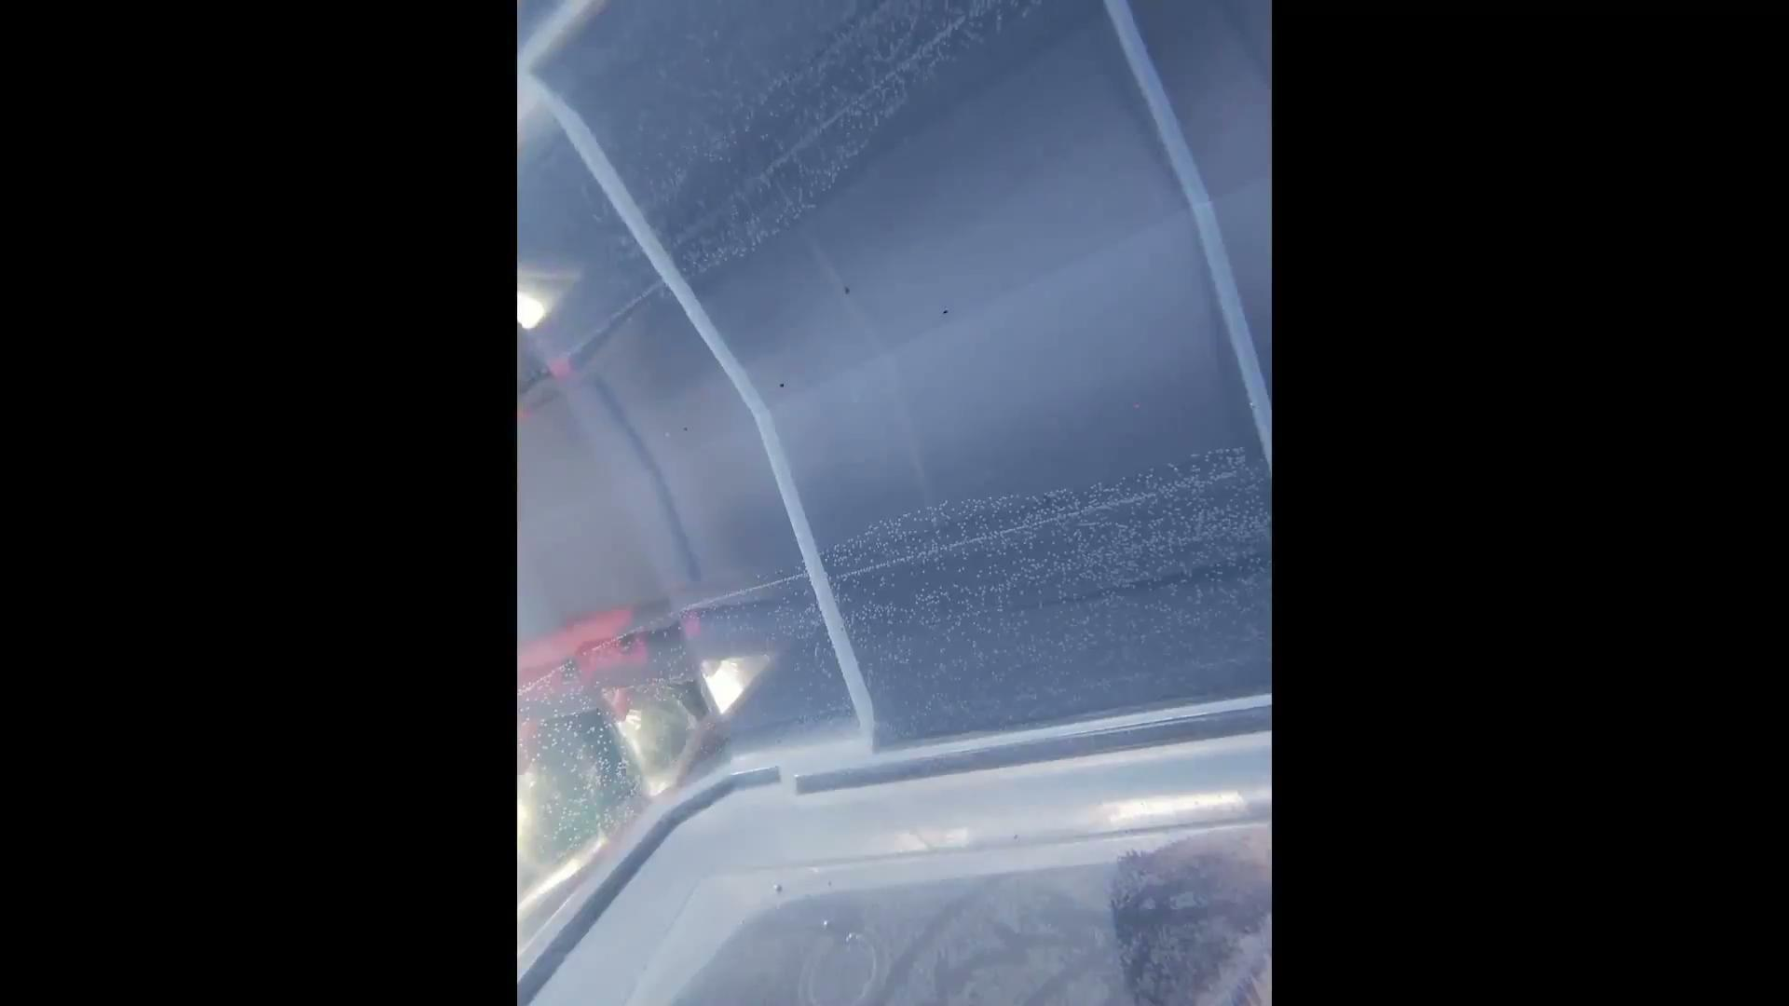

Slide 29
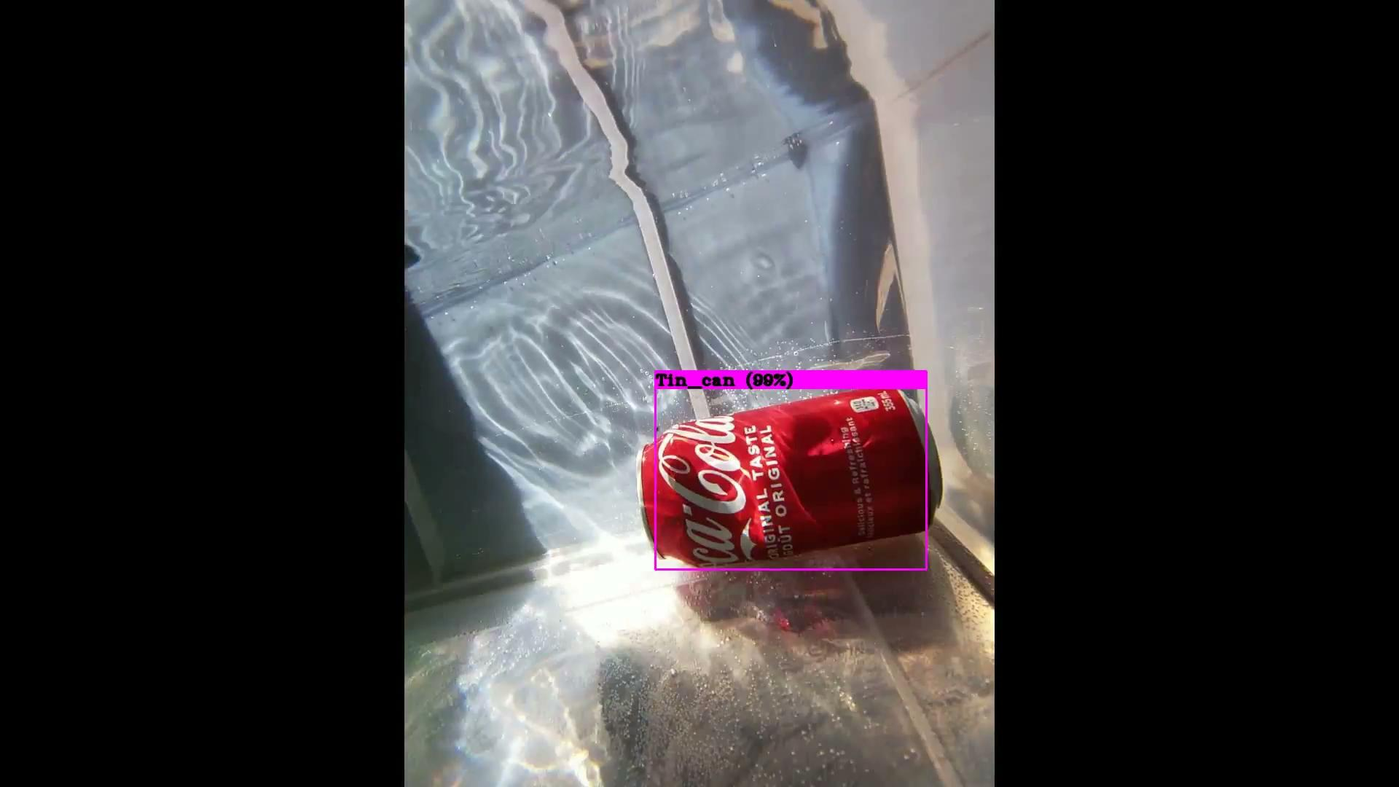

Slide 30
Website Demo

Slide 31
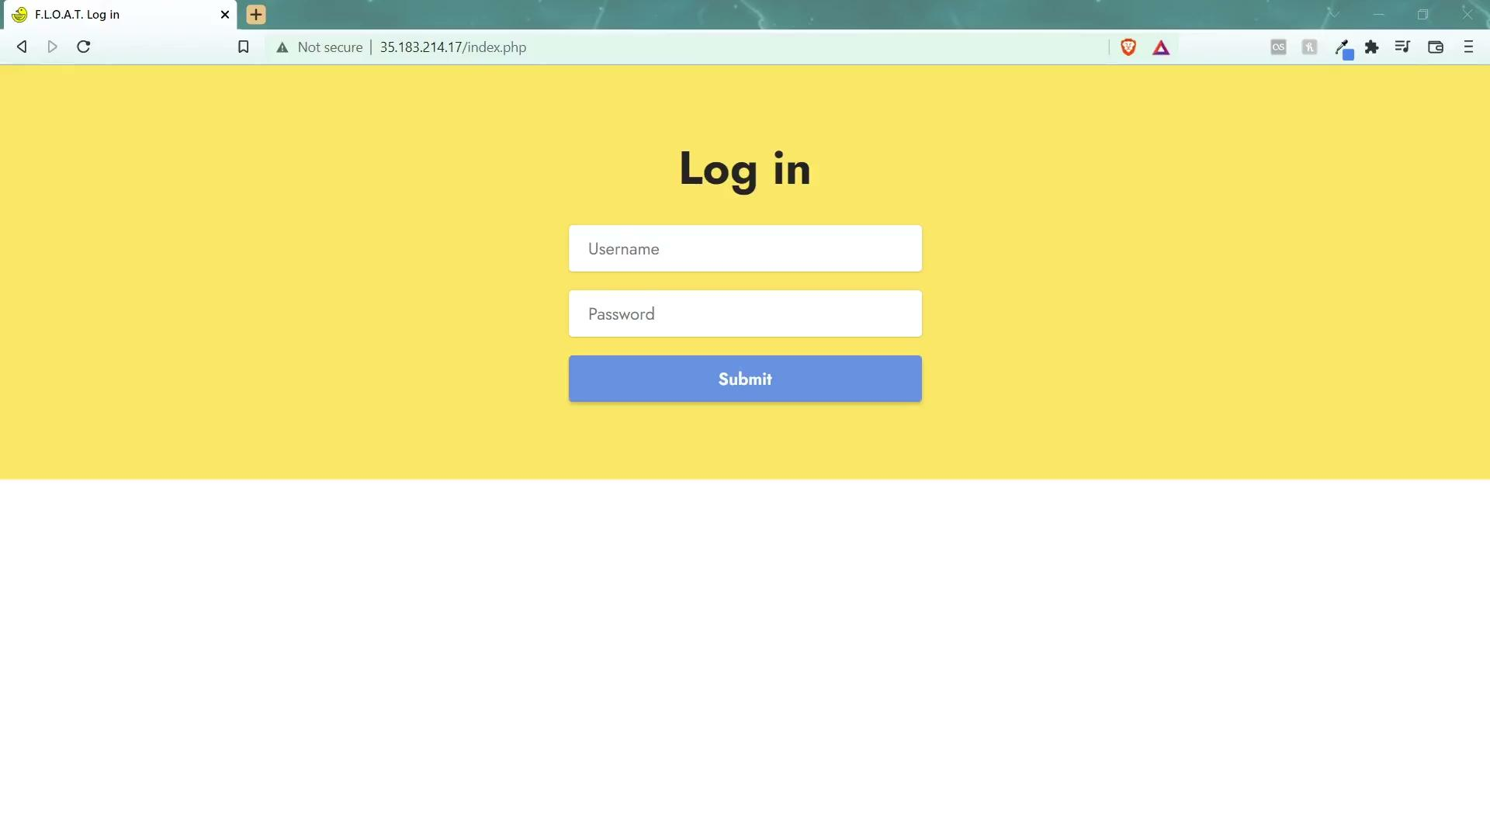

Slide 32
Where can this project go?
Government of Saskatchewan
An information gathering system for waterways in Saskatchewan
Other water-based projects
We may be a potential useful resource in the future
Expansion in other areas
With the framework we’ve made from this project, we could expand into other mediums
Future Capstone Project
We have the software, now we just need a more functional boat
Notes:
Government of Saskatchewan - This may be information they are interested in having or viewing on a more consistent and readily available basis.
Other water-based projects, potentially litter collection, may find a project like ours useful as a resource
Expansion into other areas - we’ve now got detection and data collection working well in water, there is the potential that we could move towards doing garbage detection on land in rural sask with drones.
Future capstone project - as it says on the slide, we have the software, now if we had a more efficient boat with potential litter gathering capabilities, that could be a route a future student could take.

Slide 33
Planned Future Features
Entirely mobile unit
Real-time object detection & server updating all on one singular mobile unit.
Deepsort integration
The potential to recognize and keep track of different pieces of litter across a large timeframe.
An improved classification model
Our current existing model has been trained using 5-6 objects. We have a catalog of upwards of 80 potential items we could include
Heatmap integration
Long term data integration into heat maps could prove to be valuable information to outside groups.
Notes:
Since we do consider this to be a project we enjoy, we plan to continue working on this project as time goes on. Here are the planned features we would like to implement:
Real time object detection in an entirely mobile unit
Deepsort integration to be able to recognize and keep track of individual litter
Improved classification model - 5->6, up to 80.
Heatmap integration -> this was a portion of the project we would have liked to have implemented, but due to time constraints we were unable to implement it. We feel as though a heatmap of where trash commonly gathers or flows through could be valuable information to outside groups.

Slide 34

What have we learned?
Putting in a few hours a day can go a long way
Setting out a schedule and sticking to it is crucial for success
Learning new subjects is beneficial, but not for large scale projects such as this
Last minute development changes don’t always go in your favour
Notes:
Carter:
What have we learned from this project, and what can you learn from us?
Progress is progress no matter how you look at it, a few hours of research or simple documentation development can go a long way in pushing your project forward
Setting out a schedule is imperative to your success. While development can throw curveballs at you it’s always good to have timelines set up in place and adjust accordingly
Learning curves for different languages and subjects can put a hindrance on success. Take it from us, work with what you are familiar with.
Last minute changes can either make or quite literally break your project

Slide 35
Thanks!
Any questions?
Contact:
cjb543@uregina.ca
jbv071@uregina.ca
Notes:
Carter
Thank our family
For listening to how we struggled and persevere with this project
Thank our friends
For supporting us as we built this project from the ground up

Slide 36
Special Thanks:
Christine Chan - Mentor & Project Advisor
Timothy Maciag - Mentor & Project Advisor
Ben Lichtenwald - Allowing us the use of the UofR Water Flume
Matthew Palmarin - Professional Input & Customer Opinions
Dylan Rush - 3D Printing Chassis for Electronic Components
Notes:
Carter : Special Thanks

Slide 37
Questions?

